Slide 1
Lodge Hill
28th-29th March 2022

Slide 2
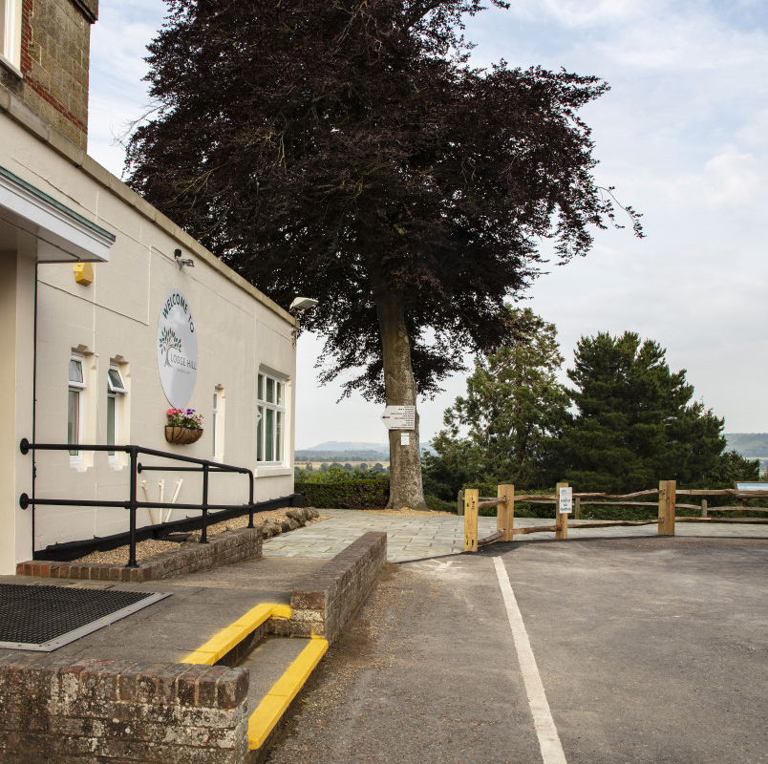
Lodge Hill
The Team –
Mrs Navarro-Hunt, Miss Tay, Miss Saumtally,Mrs Peiris, Miss Begum, Mr Ridgewell, Miss Woolley, Miss Harman
70 children accompanied by 8 members of staff

Slide 3
Monday
Please arrive at school by 8.30am.
Children are to come to the school hall with:
Overnight bag/case;
Small rucksack, which includes a snack, water and their lunchbox;
Any medication clearly labelled
The coaches will leave at 9.15am

Slide 4
Tuesday
We are due back at around 6pm.
We will let the school know if our ETA will be different and they will put this on the school website.

Slide 5
Safety
All Lodge Hill staff are DBS/Police checked, inducted and trained. They have achieved appropriate qualifications for each of the activities they teach
Lodge Hill staff are qualified First Aiders
* Lodge Hill is independently inspected by the British Activity Holiday Association (BAPA)
* Comprehensive risk assessments have been carried out on all Activities.
* Activity groups are at a ratio of 1 instructor to 12 participants [on certain activities it is a ratio of 2:12]
* Each activity is accompanied by Lodge Hill instructors & group leaders.
* The Centre have secure & clearly defined borders, with CCTV in operation.
The Lodge Hill Duty Manager is on call 24/7 for any emergencies.

Slide 6
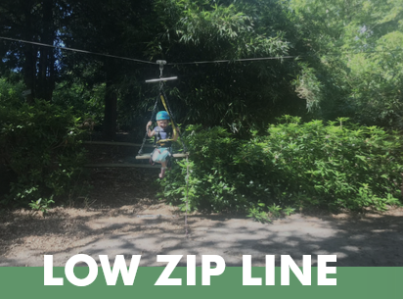
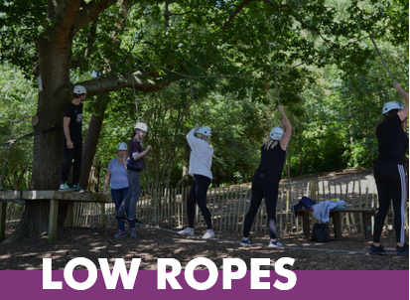
Activities
There will be 7 activity groups, each with 11/12 children.
All groups will do the same 7 activities, with each activity lasting 1 hour 30 minutes. Activities this year are –
Crate stacking, Low zip wire, Archery, Climbing, Orienteering, Low ropes, Shelter building
There will also be activities led by our staff on the Monday evening

Slide 7
Dormitories
There are 27 bedrooms on 3 separate floors.
Rooms have either 3, 4 or 6 beds. Children will have to make their own bed in the morning!
There are 14 bath/shower rooms
Adult rooms are arranged between floors
Children have chosen friendship groups and we have done our very best to ensure that they are with at least one friend.
Children will not find out rooms until much nearer the time

Slide 8
Food
Remember to bring a packed lunch and a snack for Monday
Monday
2.45 – Afternoon tea
6-7 – Dinner
9 – Bedtime drink
Tuesday
8-9 – Breakfast
10.45 – Snack
12.30-1.30 – Lunch
2.45 – Afternoon tea

Slide 9
Kit List – Please name everything
Waterproof coat
Night clothes / teddy
2 pairs underwear / socks
1 sturdy pair of shoes or trainers (that you don’t mind getting muddy)
2 pairs of tracksuit bottoms, trousers or leggings (not jeans)
2 tops – at least one with long sleeves
Sweatshirt
Binbag to put dirty clothes in
Water bottle

Slide 10
Kit List – continued
Washbag
Toothbrush and paste
Comb/brush
Face cloth
Shampoo / shower gel
Deodorant (no aerosols)
Suncream
Towel
Tissues
NO MOBILE PHONES OR ELECTRICAL DEVICES

Slide 11
Forms
All medical and consent forms should have been completed and returned to school Please could anyone who needs to add/make changes, please contact the school immediately
Please make sure that you have handed your forms in, including an dietary requirements.

Slide 12
Medical
We have first aiders amongst the school staff and all the staff at Lodge Hill are first aid trained.
Any medication must be bagged and clearly labelled and given to the first aiders on Monday morning.
If your child needs an inhaler, please bring 2. 1 in your child’s rucksack and the other will stay with the group leader
Please let us know, via your class email, if there are any other concerns – e.g. sleep walking/bed wetting

Slide 13
Behaviour – 5 Cs
Caring
Careful
Cheerful
Courteous
Co-operative

Slide 14
Emergency Contact
In an emergency, please contact the school, who will be able to reach us.
We will give out a phone number for emergency contact overnight nearer the time.

Slide 15
Thanks
Thank you for attending. If you have any questions about the trip, please could you email the class email, and we will get back to you.
This PowerPoint will be up on the parent VLE page this week, so you can check back for any information.
Class emails
curie@southwayjunior.co.uk
einstein@southwayjunior.co.uk
hawking@southwayjunior.co.uk

